Slide 1
You as a Business

Slide 2
Business on a Personal Level
Manage yourself like a business
Target Market
Marketing Mix
Finance
Think like a business person

Slide 3
Marketing You
What is your target market?
  E.g. nursing, sales, retail, finance, accounting
Do market research
  What kinds of things do they do?
  What skills are required?
  What kind of people do they need?
  Where do they hire from?
  What are their challenges (opportunities)
  Read up on their news

Slide 4
Your Marketing Mix
Product
  What skills and knowledge do you have?
  What differentiates you in your market?
    Why should someone hire you over someone else?
Price
  What can you earn? Why?
  What is your value added?
Promotion
  You need to sell yourself
  Dress for success
    How you look is sending a message
  Write for success (including emails and texts!)
    Use spell checking!!!
    Do not expect that your email is private
    Professional resumes (walnut, basketball)

Slide 5
Your Marketing Mix
Promotion
  Do not put things in Facebook or YouTube that you do not want employers to see.
  Talk for success
    “equities”, “fixed income”, “marketing mix”, CPI, GDP,etc.
  Observe what successful people wear and do
    Visualize and emulate them
  Treat interviews seriously
    Dress
    No phone, parents
  A recent study showed 83% lost their job due to attendance or attitude
Distribution
  How do you go looking for a job?
  Always network – clubs, groups, meetings, etc.
  Always be looking

Slide 6
Your Finances
Create personal financial statements
  How much do you make?
  What expenses do you have?
    put into categories such as taxes, food, housing, transportation, entertainment, medical
    pay special attention to recurring, monthly expenses
      e.g. cable, cell phone, car loan
  How much do you save?
    calculate the percent of income
A person’s worth is not what they spend but what they save.

Slide 7
Your Finances
Save aggressively
    If you start saving late, you can never catch up

Slide 8
You Can Never Catch Up
Person A: Saves $2000 per year from age 22 to age 35 and then stops
Person B: Starts saving $2000 per year beginning at age 35 and never stops
Both earn 10% on their investments.
At age 75:
Person A has $1M in savings
Person B has $561K in savings

Slide 9
Years to “Financial Freedom”
Savings Rate | Years to “Freedom” | Age when “Free”
5% | 50 | 72
10% | 40 | 62
15% | 34 | 56
20% | 30 | 52
25% | 26 | 48
Assumes:
- 7% annual rate of return.
- Start saving at age 22.
Source: http://www.forbes.com/sites/robertberger/2015/03/03/
how-much-of-your-income-should-you-save/2/?ss=retirement

Slide 10
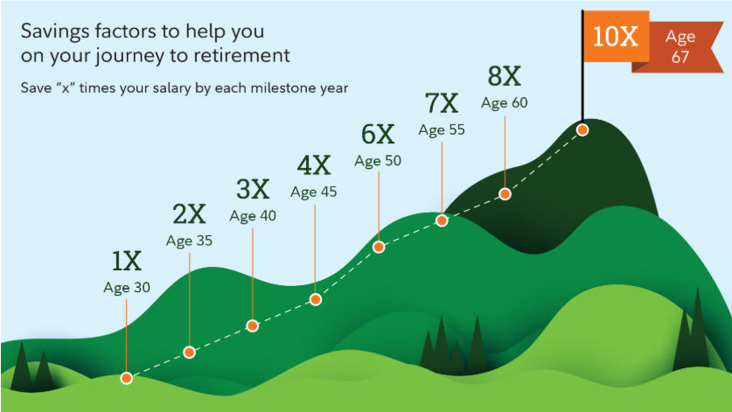
Target Savings by Age
Source: https://www.fidelity.com/viewpoints/

Slide 11
Your Finances
Save aggressively
  Establish a savings level (at least 15%, think 20+%)
    “Pay yourself first”
    Take pride in your savings, not your stuff
  Plan to save a little each month for future major items, e.g. a car
  Avoid debt, except for a mortgage
    always pay off credit card balances
    if can not pay off balance, do not buy
Keep track of your expenses
  Don’t spend like a millionaire until you are one.

Slide 12
Mistakes Rich People Never Make
Failing to show up
  Grant Cardone, founder of Cardone Capital, a $750 million real estate empire.
Slacking off
  Michael Ovitz, co-founder and former chairman of CAA; former president of The Walt Disney Company
Having a negative attitude
  Barbara Corcoran, founder of The Corcoran Group; podcast host of “Business Unusual”; “Shark Tank” investor
Not Smiling
  Holly Parker, founder and CEO of The Holly Parker Team at Douglas Elliman; award-winning broker who has made over $8 billion in sales
  Source:https://www.cnbc.com/2020/01/13/mistakes-rich-and-successful-people-never-make-according-to-self-made-millionaires.html

Slide 13
Your Finances
Create your personal balance sheet
Your net worth = assets – liabilities
Keep track over time
How much will you need in the future?
Net
Worth
Year

Slide 14
Investing
401(k)
  if your employer contributes, it is free money
Roth IRA
Securities
  Be skeptical of financial advisors
  Diversify
    Don’t try to out-pick the pros
    What do you know that the pros don’t
    Indexed mutual funds, ETFs
    How did those NFTs work out?
  Buy and hold
    Don’t try to time the market, don’t chase returns
Don’t invest like a millionaire until you are one.

Slide 15
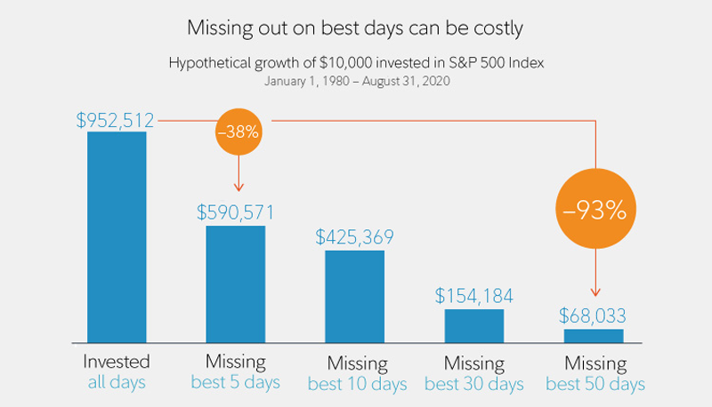
Source: Fidelity, FMRCo, Asset Allocation Research Team

Slide 16
Your Financial Future
The most important financial action you can take is to save.
  Don’t spend like a millionaire until you are one
Save
Do not count on wise investing to make you rich.
  Don’t invest like a millionaire until you are one

Slide 17
Twelve Financial Truths
Jonathon Clements, WSJ 6/18/06
It’s hard to cut back
You will never be satisfied
Borrowings have to be repaid
Fancy cars and expensive clothes are not a sign of wealth
Your family could prove to be your greatest liability
Investors face three enemies
  Inflation
  Taxes
  Investment costs

Slide 18
Twelve Financial Truths
Jonathon Clements, WSJ 6/18/06
Adding investments can lower risk
Diversification is a mixed bag
Not all risk is rewarded
Most investors fail to beat the market
Change is costly
Your best investment strategy is saving

Slide 19
Other Financials
Insurance
  Life – need changes over time
    Always buy term insurance, never whole life
  Medical
  Auto
  Home
Expenses
  Never pay retail
    Use store cards
    Wait for sales
    Negotiate
    It’s like a tax-free raise

Slide 20
Think Like a Business Person
Prices and products reflect the consensus of the market
  The “Invisible Hand”
  Individuals and governments do not make better decisions than the market
Profits are the reward for taking risks
Embrace frustrations and problems
  They are business opportunities
Do not think with your emotions, use what you have learned.
Do not let others think for you. You do the hard work.

Slide 21
Treat Yourself Like a Business
Plan for success
  Your career
  Your finances
Work at it
  Education
  Job
  Saving
Enjoy it
  Take pride in your work
  Take pride in your savings

Slide 22
Keys to Success
Show up early
Work hard
Smile
AND
Save!

