Slide 1
Investing Fundamentals
©William Klinger. This work is licensed under a Creative Commons Attribution 4.0 license

Slide 2
Learning Objectives
Understand what securities are.
Know the basic asset classes.
Know what asset allocation is and why it is important.
Understand the basic investment choices.
Be able to create a basic investment plan.

Slide 3
Securities
Investment instruments
Represent an obligation by issuer

Slide 4
Securities
Stocks = Equities = ownership of a company
Bonds = Fixed Income = Debt of a company

Slide 5
The Markets
Primary market
New securities issues are first sold to investors
Issuer receives the proceeds from the sale.
Initial Public Offering (IPO)
Secondary market
Previously issued securities are traded among investors.
Examples: NY Stock Exchange and the NASDAQ

Slide 6
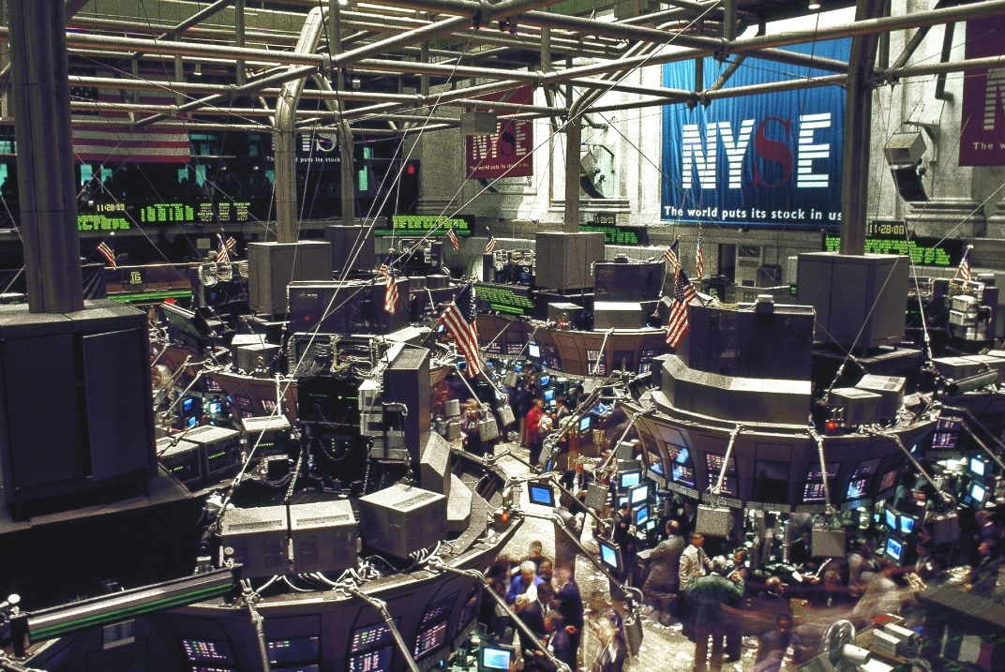
Securities Exchanges
The New York Stock Exchange
NYSE (Big Board)—the largest, and probably the most famous, stock market in the world
Also one of the oldest, founded in 1792
Notes:
1. is the largest, and probably most famous, stock market in the world
2. Today more than 4,000 common and preferred stock issues are traded on the NYSE, and represent most of the largest, best-known companies in the U.S.
3. Buying and selling takes place face-to-face on a trading floor, and buy and sell orders are transmitted to one of 42 posts - each stock is assigned a post - on the floor of the exchange.
4. Even though the NYSE retains a trading floor, the exchange has become highly automated in recent years.
5. Its computer systems automatically match and route most orders, which are typically filled in a few seconds.

Slide 7
Securities Exchanges
The NASDAQ Stock Market
NASDAQ stock market—second-largest stock market in U.S., trading stock issues of firms that are typically smaller, less well-known than those on the NSYE
Made up of many technology companies

Slide 8
Securities Exchanges
Foreign Stock Markets
Virtually all developed, and many developing, countries have stock exchanges
Examples include Bombay, London, Helsinki, Hong Kong, Mexico City, Paris, and Toronto

Slide 9
Securities
Major asset classes
Cash
Bonds (fixed income)
Stocks (equities)
What are the risks & pros of each?
Asset allocation
Percent of assets in each asset class
Very important concept in investing

Slide 10
Cash
Securities do not go down in nominal value
Returns come from interest
Money Market Instruments
Short-term debt securities
Mature within one year
Examples:
U.S. Treasury Bills,
Certificates of Deposit (CDs)
Treasury Bills, (T-Bills) are special
The “risk-free asset”
Notes:
Generally low-risk securities that are purchased by investors when they have surplus cash.

Slide 11
Bonds (Fixed Income)
Attributes
Par value
Amount on the bond (principal)
Usually $1000
Interest rate
Cost of borrowing
Usually paid 2x a year
Maturity date
When principal is paid back
Interest payments do not change over the life of the bond

Slide 12
Types of Bonds
Corporate Bonds
Secured Bond—bond backed by a pledge of a company’s specific assets. (Think collateral)
Debenture—bond backed by the reputation of the issuer. (Think IOU)
Notes:
Secured bond
a. backed by a specific pledge of company assets
b. firms can issue secured bonds at lower interest rates than would be to paid for comparable unsecured bonds.
Unsecured bond
a. also called a debenture
b. is backed only by the financial reputation of the issuing corporation

Slide 13
Types of Bonds
Government Bonds
Issued by U.S. Treasury
Sovereign debt
Municipal Bonds
Issued by state and local governments
General obligation
Proceeds are used to pay for a non-revenue producing project (e.g., a library)
Revenue bond
Proceeds are to be used to pay for a project that will produce revenue (e.g., a toll bridge)
Notes:
Government bonds
a. bonds issued by the U.S. Treasury
b. are backed by the full faith and credit of the U.S. government
c. they are considered the least risky of all bonds.

Slide 14
Bond Risk
Default risk
Company or government is unable to pay
Interest rate risk
Interest payment does not change (fixed income)
If market interest rates change, it will affect how much people are willing to pay for the bond – the bond price
Rates go up -> price goes down and vice versa
Inflation risk – same story as interest rates

Slide 15
Bond Returns
Interest
Usually paid twice a year
Contractually obligated to pay
Yield = interest payment / current price
Par value
Paid at maturity
Usually $1000
If sell before maturity
Price has probably changed from $1000
Will have a capital gain or loss

Slide 16
Bond Ratings
Investment Grade
Junk
Warning, junk bonds are often called “high yield” bonds

Slide 17
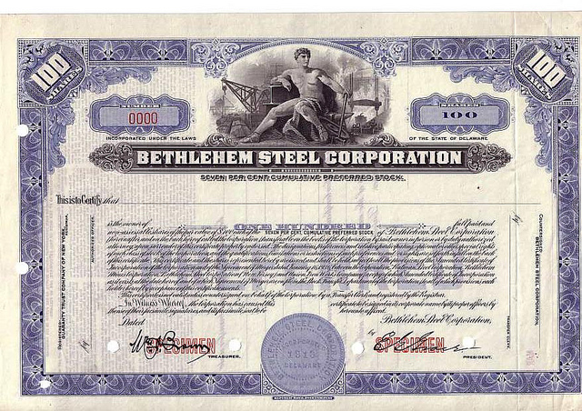
Stocks (Equities)
Represent ownership
Types
Common stock
Preferred stock

Slide 18
Equity Returns Dividends
Common stock
Optional
Usually quarterly
Sometimes one-time event
Not guaranteed for common stock
Preferred stock
Fixed, “guaranteed” dividend
Similar to bonds, but no maturity date.
Why are they called preferred stock?
If you reinvest the dividends, are they taxable?
Yield
= dividend / price

Slide 19
Equity Returns Change in Price
Based on investors’ view of a firm’s future
Will cause a capital gain or loss
Which changes in price more, common or preferred stock?

Slide 20
Risk – By Asset Class
 | Worst Annual Return Since 1925 | Average Annual Return Since 1925
Stocks | -43.4% (-67.6% worst 12 mo.) | 9.6% (162.9% best 12 mo.)
Bonds | -7.8% | 5.5%
Cash | .1% | 3.7%
Sources: personal.fidelity.com, Morgan Stanley, www.efficientfrontier.com, Federal Reserve – St. Louis

Slide 21
Asset Allocation
Depends upon investment objectives
Which asset class is best/worst if your investment objective is:
Preserving your money (it can not go down)
You want to maximize your investment growth
You want money available for emergencies
You want income now to live on
E.g. retirees, widows and orphans

Slide 22
Asset Allocation
Percent of portfolio in each asset class
Determined by:
Risk you are willing to take
Investment objectives
Rule of thumb
Cash = 3 to 6 months of expenses
(for emergencies)
% Equities = 100 – your age

Slide 23
Buying and Selling Securities
Brokerage Firm — firm that buys and sells securities for individual and institutional investors.
E*trade: An Online Brokerage Firm
Notes:
Choosing a brokerage firm, and a specific stockbroker, is one of the most important decisions investors make.

Slide 24
Buying and Selling Securities
Placing an Order
Market order instructs a brokerage firm to trade at the best available price
Lowest if buying
Highest if selling
Limit order sets a limit on amount willing to pay or sell at
Notes:
An investor’s request to buy or sell stock at the current market price is called a market order, which instructs a brokerage firm to obtain the highest price - if the investor is selling, or the lowest price - if the investor is buying.

Slide 25
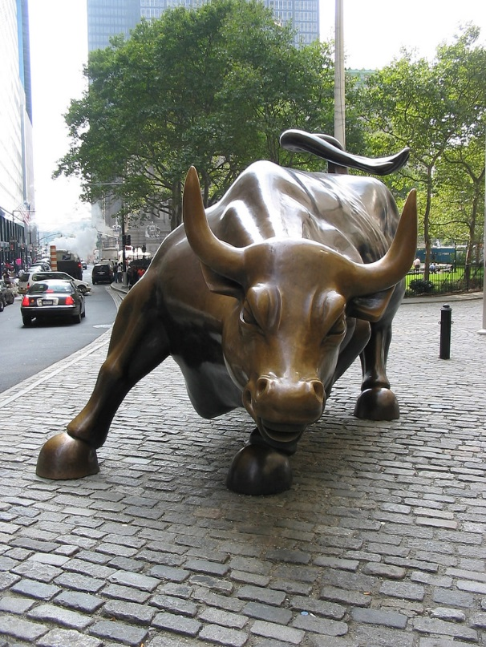
How’s the Market Doing?
Bull market
Bear market
Need to measure the market

Slide 26
Stock Indexes
Attempt to measure activity of the market
Most common indices
Dow Jones Industrial Average (Dow or DJIA)
Standard & Poor’s 500 (S&P 500)
NASDAQ composite
Foreign indices
DAX (Germany)
FTSE, FT-100 or “Footsie” (London),
Nikkei (Tokyo)

Slide 27
Funds
Mutual Funds
Investors pool their money to buy investments (stocks and bonds)
Investors become part owners of a large number of securities,
lessen their individual risk
Index funds / Managed Funds
Load / No Load Funds
ETFs
Invested like a mutual fund
Trade like a stock

Slide 28
Discussion
The Fed announced a rate hike.
What do you expect to happen to bond yields?
What do you expect to happen to bond prices?
If long-term yields do not increase, what might that tell you?
There is a drought in California
What businesses will be affected?

