Slide 1
Managing Human Resources
©William Klinger. This work is licensed under a Creative Commons Attribution 4.0 license
Adapted from Fundamentals of Business
Download this book for free at: https://vtechworks.lib.vt.edu/handle/10919/84848

Slide 2
Review
What is the difference between intrinsic and extrinsic motivation?
What do firms provide to satisfy these needs:
Physiological
Safety
Social
Self-esteem
Self-actualization
What are hygiene factors? Examples?
Describe Expectancy and Equity Theories.

Slide 3
Learning Objectives
Understand human resource plans.
Explain how companies train and develop employees and the value of diversity.
Identify factors that make an organization a good place to work.
Explain how managers evaluate employee performance and retain qualified employees.
Adapted from Fundamentals of Business
Download this book for free at: ttp://hdl.handle.net/10919/70961

Slide 4
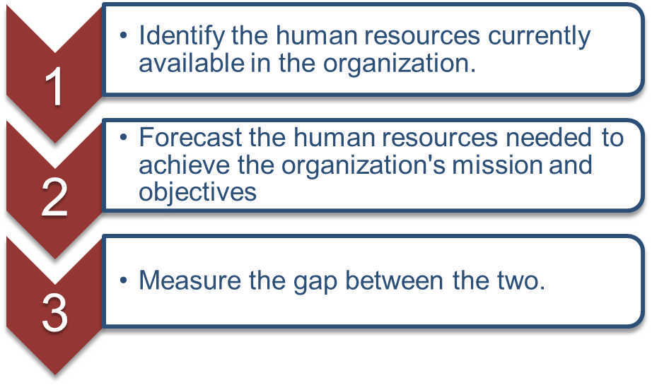
Human Resources (HR) Planning
Job analysis
Job description
Job specification
Supply and demand forecasting
Expected turnover (losses)
Expected needs
Figure CC BY 4.0. Retrieved from: https://commons.wikimedia.org/wiki/Category:Figures_from_Fundamentals_of_Business_by_Skripak
Notes:
The job description includes:
Name of the job
Organization and hiring manager
Location and maybe hours of work
Type of work
Minimum qualifications
Desired qualification
Turnover of employees is how often people leave. Often it is calculated as the percent of staff that leave in a year. Restaurants typically have high turnover.

Slide 5
Defines Hiring Process
Develops staffing plans based on strategies and needs
Hiring process
Require job description
Advertises for qualified candidates
Reviews applications
Interviewing done by hiring organization
Prepares offer
Notes:
Plan the number of employees and skills needed.
Adjust the workforce to meet changes
Plan how to attract and keep good employees
a. Right combination of pay, benefits and working conditions
b. Create and market the environment to attract the correct employees.

Slide 6
Recruiting
Internally
Externally
Corporate website
Employment websites
Social Media
Campus recruiting
Internships
Ads
Job fairs

Slide 7
Selection Process
Application
Employment tests
Drug
Aptitude
Interview process
Physical exam
Reference checks

Slide 8
Diversity of Workforce
Increasing diversity of workforce
What are the benefits of a diverse workforce?
Group | Total | Males | Females
All employees | 100% | 53% | 47%
White | 79% | 54% | 46%
African American | 12% | 47% | 53%
Asian/Pacific Islander/Other | 9% | 53% | 47%
Hispanic/Latino Ethnicity | 16% | 58% | 42%
Photo CC BY 4.0. Retrieved from: https://commons.wikimedia.org/wiki/Category:Figures_from_Fundamentals_of_Business_by_Skripak

Slide 9
Antidiscrimination Laws
Civil Rights Act
Prohibits discrimination based on race, color, religion, sex, national origin
Equal Pay Act
Age Discrimination Act
Protects workers over 40
Americans with Disabilities Act
Equal Employment Opportunity Commission (EEOC)
Enforces federal laws

Slide 10
Contingent Workers
Temporary
Part-time
Contractors

Slide 11
Developing Employees
New-employee orientation
Training
Job redesign
Job rotation
Job enlargement
Job enrichment
Notes:
Job redesign might be used to tailor a job to a person’s strengths.
Job rotation moves people around to different jobs. Downside is that it is costly and probably not as efficient.
Job enlargement is simply adding more tasks for a person to do.
Job enrichment is when the job is made more fulfilling, possibly by giving more responsibility and authority.

Slide 12
Alternative Work Arrangements
Flextime
Compressed workweeks
Job sharing
Telecommuting
Notes:
Flextime – let employees choose their hours of work, within some constraint.
Compressed workweeks have employees working 40 hours in 4 days, leaving three day weekends.
In job sharing, two people have one job. They share it by working different days.

Slide 13
HR Defines Compensation Plan
Wage and salary structure
Piecework
Commissions
Incentive programs
Bonus plans
Profit-sharing plans
Employee Stock Ownership Plan (ESOP)
Stock options
Notes:
Wages – hourly pay.
Salary – pay for a period, such as a year.

Slide 14
HR Defines Benefits
Insurance
Health
Life
Disability
Various
Legal help
Adoption help
Laundry
Others

Slide 15
HR Defines Retirement Benefits
Defined benefit plans
Aka pension plans
Retirement income defined by formula
Based on age and years with firm
Employee does not contribute
Defined contribution plans
E.g. 401(k), 403(b)
Employer pays into account for employee
Employee may contribute
Company may match employee contribution

Slide 16
Tax-Advantaged Accounts
 | 401(k) | IRA | Roth IRA
Contributions are tax-deductible | Yes | Yes | No
Investments grow tax-free | Yes | Yes | Yes
Earliest withdrawal age | 59½ | 59½ | 59½
Withdrawals taxed | Yes | Yes | No
Employers contribute | Usually | -- | --
Min. initial contribution - typical bank (mmkt /CD) | None -- | $3,000 $25/$300 | $3,000 $25/$300
Max. annual contribution | $18,000 | $5,500 | $5,500

Slide 17
HR Benefits and Programs
Family-friendly programs
Dependent care
RVCC provides on-site day care
Paid parental leave
Vacation days
Personal days

Slide 18
Flex (Cafeteria-style) Benefits
Not all workers have same benefit needs
Different life stages
Different family status
Allow workers to purchase benefits they need
Usually limited to
Health insurance
Life insurance

Slide 19
Performance Appraisal Process
HR defines
How to do it
When to do it
Appraisal should be
Based on objectives
Written
Acknowledged by employee

Slide 20
Performance Appraisal Process
Photo CC BY 4.0. Retrieved from: https://commons.wikimedia.org/wiki/Category:Figures_from_Fundamentals_of_Business_by_Skripak

Slide 21
Performance Appraisal Process
360-Degree review
Feedback from manager, peers, direct reports
Upward feedback
Feedback from subordinates
Notes:
An example of upward feedback is Start/Stop/Continue.

Slide 22
Employee Termination
HR defines the process
Employment at will
Termination for performance
Downsizing
Notes:
Downsizing means layoffs. The business is getting smaller.

