Slide 1


Marketing:
Providing Value to Customers
©William Klinger. This work is licensed under a Creative Commons Attribution 4.0 license
Adapted from Fundamentals of Business
Download this book for free at: https://vtechworks.lib.vt.edu/handle/10919/84848

Slide 2
Review
What is the term for the contract between management and a union?
What are mediation and arbitration?
What are the tactics unions and management use to influence the other side?

Slide 3
Learning Objectives
Define marketing, marketing concept, and marketing strategy.
Know the tasks used in selecting a target market.
Identify the marketing mix.
Explain marketing research.
Discuss various branding strategies.
Describe the promotion mix
Know how firms manage customer relationships.
Identify the advantages and disadvantages of social media marketing.
Adapted from Fundamentals of Business
Download this book for free at: ttp://hdl.handle.net/10919/70961

Slide 4
Marketing
More than advertising and sales
Includes
  Defining product
  Pricing
  Identifying target market
  Promotion
  Delivery
  Customer relationships
Delighting the customer

Slide 5
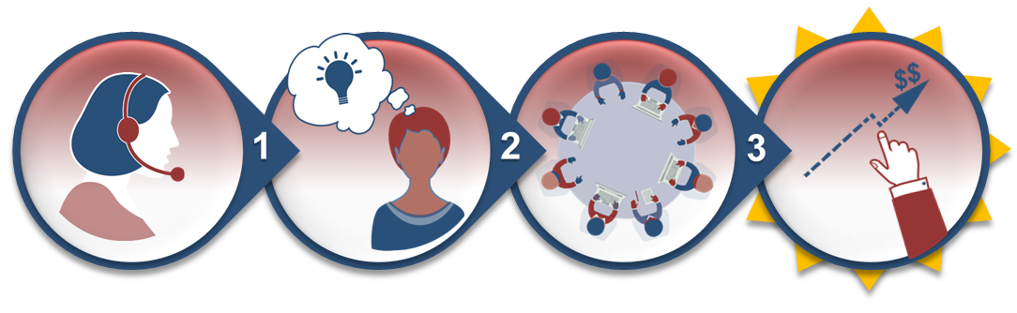
Marketing Concept
Satisfying customers
Meeting organizational goals
Figure CC BY 4.0. Retrieved from: https://commons.wikimedia.org/wiki/Category:Figures_from_Fundamentals_of_Business_by_Skripak

Slide 6

Target Market
Potential customers
Types of markets
  Consumer market
    End users
  Industrial (commercial) market
    Buyers use to make other products
Market share
  Firm’s sales as a percentage of total market

Slide 7
Market Segmentation
Dividing target market into smaller groups
Customers in segment have common characteristics
  Demographics
    E.g. age, marital status, ethnicity, gender, income
  Geographics
    Region or area
  Behaviorial
    Attitudes, status, rate of use
  Psychographics
    Interests, activities, values
Clustering – combining multiple characteristics

Slide 8
Market Segmentation
How might you segment these markets?
  Cars
  Handbags
  Cleaning products
  Cereal
  Shoes
  Alcohol
  Shampoo

Slide 9
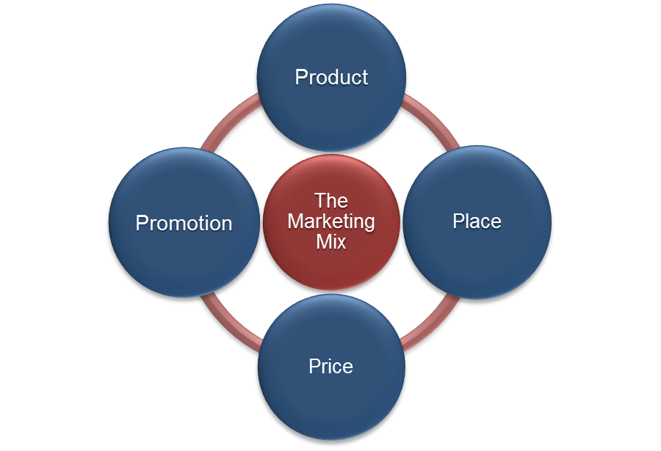
Marketing Mix
Product
Price
Promotion
Place (distribution)
Figure CC BY 4.0. Retrieved from: https://commons.wikimedia.org/wiki/Category:Figures_from_Fundamentals_of_Business_by_Skripak
Notes:
Many people talk about the “Four P’s” when they describe the marketing mix. We’ll see why “place” does not fully cover the concept later.

Slide 10
Product

Slide 11
Product
What do customers need and want?
What product characteristics are important?

Slide 12
Market Research
Secondary data
  Data already available
Primary data
  Targeted data to be gotten first-hand
Common methods
  Surveys
  Interviews
  Focus groups
Notes:
Think about the data collected on you by grocery stores, credit card companies, Facebook, Google, Amazon, etc. That’s secondary data just waiting to be analyzed.

Slide 13
Market Research
Problem – Hawthorne Effect
Other methods
  Data mining
  Unobtrusive observation
  Tracking eye movement viewing ads
Exercises – How would you do this research?
  You’ve been hired to find the market share for the radio station NJ 101.5.
  You’ve been hired to find out what TV shows college students watch and how much.
  Estimate the size of the target market for heated driveways in Somerset County.
Notes:
Hawthorne Effect – people’s behavior changes when they are being observed.
Data mining – going through data to get insight
Unobtrusive observation – watching consumers without their knowledge. For example, tracking their movements in a store.

Slide 14
Branding
Trademarks
Manufacturer’s brand
  E.g. Coach, Nike, Apple, Ford, Gucci
Private label brands
  E.g. Nature’s Promise, Kirkland, ShopRite
Generic

Slide 15
Brand Equity
Brand name has value
  E.g. Apple, Gucci, Ferrari
Levels
  Brand awareness
  Brand preference
  Brand insistence

Slide 16
Packaging
Part of the product
What products have distinctive packaging?
  Unique shape
  Color(s)
  Font

Slide 17
Place (Distribution)
Notes:
Much more than place. Think of Amazon. During the pandemic businesses had to find ways to get their product out when customers couldn’t come into their stores.

Slide 18
Place (Distribution)
Most Common Types of Retailers
Type of Retailer | Description | Examples
Category Killer | Sells a wide variety of products of a particular type, selling at a low price due to their large scale | Dick’s Sporting Goods
Convenience Store | Offers food, beverages, and other products, typically in individual servings, at a higher price, and geared to fast service | 7-Eleven
Department Store | Offers a wide assortment of products grouped into different departments (e.g., jewelry, apparel, perfume) | Nordstrom, Macy’s
Discount Store | Organized into departments, but offer a range of merchandise generally seen as lower quality and at a much lower price | Target, WalMart
Specialty Store | Offers goods typically confined to a narrow category; high level of personal service and higher prices than other retailers | Local running shops or jewelry stores
Supermarket | Offers mostly consumer staples such as food and other household items | Kroger, Food Lion
Warehouse Club Stores | Offers a wide variety of products in a warehouse-style setting; sells many products in bulk; usually requires membership fee | Costco, Sam’s Club
Figure CC BY 4.0. Retrieved from: https://commons.wikimedia.org/wiki/Category:Figures_from_Fundamentals_of_Business_by_Skripak

Slide 19
Distribution
Much more than retail location
Distribution channels
Manuf.
Agent /
Broker
Wholesaler
Retailer
Consumer
Manuf.
Wholesaler
Retailer
Consumer
Manuf.
Retailer
Consumer
Manuf.
Consumer
Notes:
Distribution channel – the path of a product from the manufacturer to the consumer.

Slide 20
Distribution
Channel conflict
  Different channels compete with each other
  Retailers have different costs
  Result in different prices to consumers
  Retailers may go to other products
Manufacturers want to avoid conflict
  Want to use all channels
  Establish MSRP, Manufacturer’s Suggested Retail Price

Slide 21
Physical Distribution
Logistics and Physical Distribution
  Warehousing—storing products as they move through the distribution channel
    Storage warehouses
    Distribution warehouses
  Materials Handling
  Order Processing (Fulfillment)
  Vendor-Managed Inventory
Developing area
  Two-hour delivery
  Drone delivery
  Employee delivery
Notes:
Two types of warehouses, including:
•storage warehouse - hold goods for moderate to long periods to balance supply and demand between producers and purchasers
•distribution warehouse - temporary storage facilities, often holding goods for 24 hours or less
Materials Handling
a. The physical distribution activity that moves items within plants, warehouses, transportation terminals, and stores.
b. Costs rise every time an item is handled.
c. Techniques are used to help firms accomplish the goal of only taking steps that add value, including:
•unitization - combining as many packages as possible into one load to be handled by a single truck or forklift
•containerization - collects packages, usually from several unitized loads, into a compact form that is relatively easy to transfer
Inventory Control
a. Involves balancing the priority of limiting costs of holding stock with meeting customer demand through a variety of management methods
b. Advance computer processing, large retailers are no longer just managing inventory, but rather the entire supply chain
Order Processing or Fulfillment
a. Includes all the tasks required to prepare customer orders for shipment
b. Involves the steps of receiving shipments, as well

Slide 22
Promotion

Slide 23
Promotion Strategies
Pull strategy
  Stimulate demand from final users
  Examples?
Push strategy
  Stimulate personal selling of the good or service
  Examples?
Notes:
An example of a push strategy is when a business will give the sales people at a retailer an incentive to sell a particular product.

Slide 24
Types of Promotion
Advertising
  TV, radio
  Newspapers, magazines
  Internet, social media
  Limited only by imagination
Personal selling
Sales promotion
Public relations (PR)

Slide 25
Types of Promotion
Exercise – how many different types of promotion can you name?
  E.g. Product placement
Notes:
Product placement – putting a product where the audience sees it in TV shows, movies, video games.

Slide 26
Interacting with Customers
Customer-relationship management
  Goal – retain customers
  Keep in contact with customers
Social media marketing
  Low cost
  Gather data about customers
  Allows customers to interact
  Can be overwhelming for firm
  Privacy issues

Slide 27
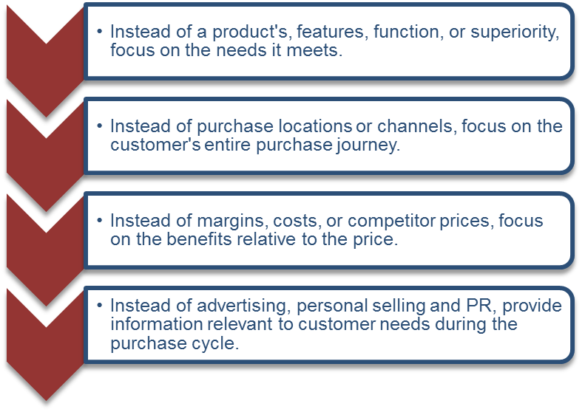
SAVE Marketing Model
Solution
Access
Value
Education
Figure CC BY 4.0. Retrieved from: https://commons.wikimedia.org/wiki/Category:Figures_from_Fundamentals_of_Business_by_Skripak

