Slide 1


Motivating Employees
©William Klinger. This work is licensed under a Creative Commons Attribution 4.0 license
Adapted from Fundamentals of Business
Download this book for free at: https://vtechworks.lib.vt.edu/handle/10919/84848

Slide 2
Review
Describe activities of operations management.
What factors do firms consider in their location decision?
What is a PERT and Gantt chart?
Explain how manufacturing companies use technology.
Distinguish service operations and manufacturing.
What is total quality management, TQM?
What is outsourcing? Give an example.

Slide 3
Learning Objectives
Define motivation and understand why it is important in the workplace.
Understand intrinsic and extrinsic motivation.
Explain the major theories of motivation:
  The Hierarchy of Needs theory
  The Two-Factor theory
  Expectancy theory
  Equity theory
Adapted from Fundamentals of Business
Download this book for free at: ttp://hdl.handle.net/10919/70961

Slide 4
Sources of Motivation
Intrinsic
  From within
  E.g. satisfaction
Extrinsic
  From external factors
  E.g. reward

Slide 5
Maslow’s Hierarchy of Needs Theory
 | Personal fulfillment | Professional fulfillment
Highest: Self-Actualization | Creative success and achievement | Challenging work, leadership, professional achievement
Esteem | Status and respect | Authority, titles, recognition
Social | Family and friendships | Team membership and social activities
Safety | Financial stability | Seniority/ Job security
Lowest: Physiological | Food and shelter | Salary
Must satisfy lower-level needs before we seek to satisfy higher-level needs
Once a need is satisfied, it no longer motivates us
Figure CC BY 4.0. Retrieved from: https://commons.wikimedia.org/wiki/Category:Figures_from_Fundamentals_of_Business_by_Skripak

Slide 6

Maslow’s Hierarchy of Needs Theory
What a implications for a manager?
Analyze these scenarios
  Firm has office parties and gym memberships. Has poor health insurance.
  Firm has great health insurance but low pay.
  Firm has good pay, benefits, and rewarding work. There are no company social activities or work recognition.
Notes:
How does Maslow’s Hierarch of Needs relate to each scenario? What need is being met and which one is not? Is the person motivated?

Slide 7
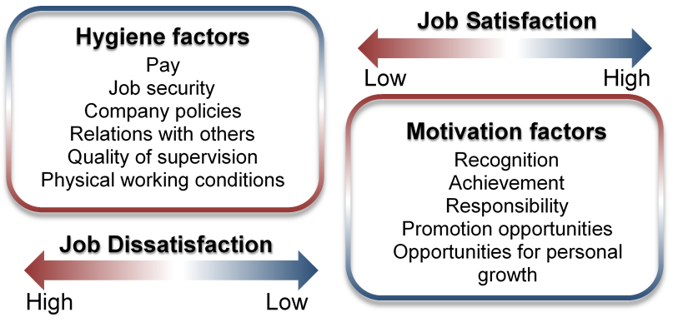
Herzberg’s Two-Factor Theory
Hygiene factors – must be present to prevent job dissatisfaction
Motivation factors – strong contributors to job satisfaction
Photo CC BY 4.0. Retrieved from: https://commons.wikimedia.org/wiki/Category:Figures_from_Fundamentals_of_Business_by_Skripak

Slide 8
Herzberg’s Two-Factor Theory
Analyze these scenarios using the Two-Factor Theory
  Firm has office parties and gym memberships. Has poor health insurance.
  Firm has great health insurance but low pay.
  Firm has good pay, benefits, and rewarding work. There are no company social activities or work recognition.

Slide 9
Expectancy Theory
Effort
Performance
Reward
Employees value the offered reward
Employees believe that acceptable performance will earn them the desired reward.
Employees believe that effort will produce an acceptable performance.
Employee is motivated if he or she
Believes efforts will result in acceptable performance
Believes acceptable performance will lead to desired reward
Values the reward
Photo CC BY 4.0. Retrieved from: https://commons.wikimedia.org/wiki/Category:Figures_from_Fundamentals_of_Business_by_Skripak

Slide 10
Expectancy Theory
Analyze these scenarios using Expectancy Theory
  You want a promotion. You believe you can get a new customer. Getting the new customer is not likely to get you promoted.
  You want a bonus and believe that completing the project will get you a bonus. You do not think you can complete the project.
  You have been told that if you fix a manufacturing problem you will get a new assignment you want. You believe you can fix the problem.

Slide 11
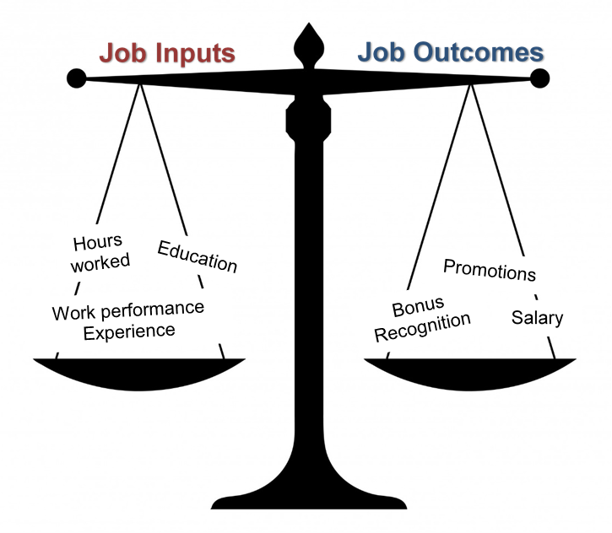
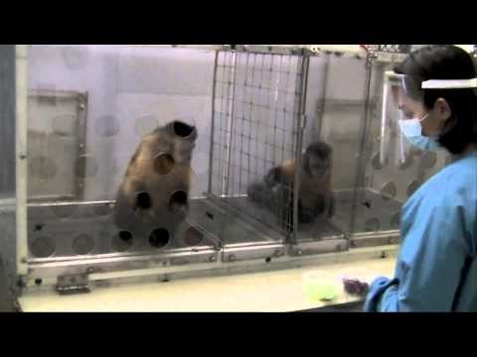
Equity Theory
Evaluate how fairly we are treated relative to others
Compare the
outcome to the
input
Photo CC BY 4.0. Retrieved from: https://commons.wikimedia.org/wiki/Category:Figures_from_Fundamentals_of_Business_by_Skripak
Notes:
Equity here has nothing to do with finance (sorry for any confusion, not my choice of words). Equity here means “equal”. Is the employee being treated equally?

Slide 12
Equity Theory
Analyze these scenarios using Equity Theory
  You and Sue work overtime for a week. Sue gets a $500 bonus and you get no bonus.
  You work 20 hours of overtime and get a $400 bonus. Tom worked 40 hours of overtime and got an $800 bonus.
Can one motivation theory explain all situations? If not, give an example situation.

Slide 13

Stages of Team Development
Forming
Storming
Norming
Performing
Notes:
Look at the teamwork!

