Slide 1


Operations Management
©William Klinger. This work is licensed under a Creative Commons Attribution 4.0 license
Adapted from Fundamentals of Business
Download this book for free at: https://vtechworks.lib.vt.edu/handle/10919/84848

Slide 2
Review
Identify the levels of management.
What type of planning is done by each level?
What are the different types of organization structures?
What are the strengths and weaknesses of each organization structure?
What characteristics do organizations have?
What is the difference between responsibility and authority? Can there be problems?

Slide 3
Learning Objectives
Describe activities of operations management.
Understand PERT and Gantt charts.
Explain how manufacturing companies use technology.
Describe the product delivery process.
Distinguish service operations and manufacturing.
Understand total quality management and outsourcing.
Adapted from Fundamentals of Business
Download this book for free at: ttp://hdl.handle.net/10919/70961

Slide 4
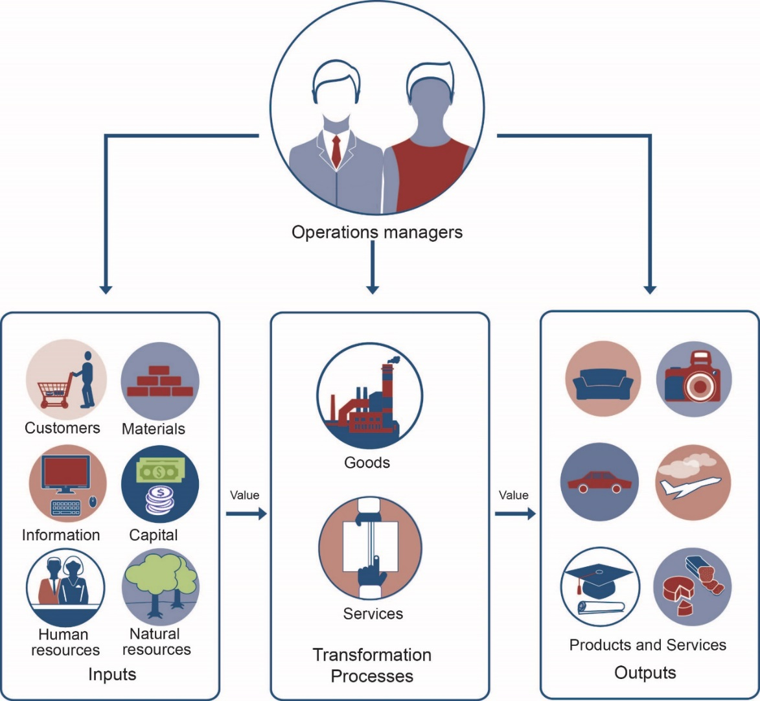
Operations Management (OM)
Converting resources into goods or services
Figure CC BY 4.0. Retrieved from: https://commons.wikimedia.org/wiki/Category:Figures_from_Fundamentals_of_Business_by_Skripak

Slide 5
Operations Management
Responsibilities
Production planning
  Where and how
Production control
  Schedule and monitor
Quality control
  Meet standards

Slide 6
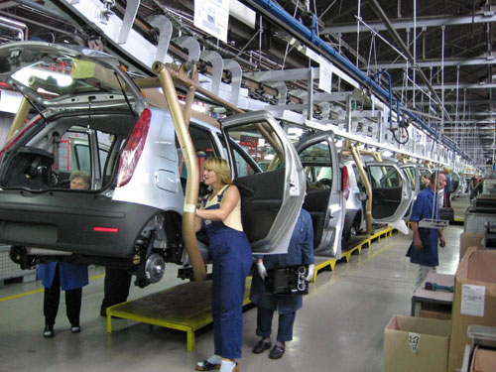
Production Process Planning
Type of process
Make-to-order
Mass production
Mass customization
Notes:
Mass customization is where you mass produce a product but each one might be customized. For example, Nike shoes. They are made in large batches and yet you can order a customized shoe.

Slide 7
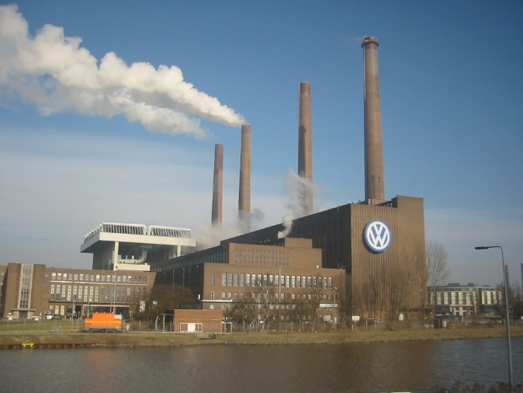
Production Process Planning
Facilities site selection
Facilities site selection
Locate close to
Customers or supplier
Skilled labor
Natural resources
Transportation
Quality of life
Low cost
Favorable government

Slide 8

Production Process Planning
Facilities site selection
Where would you locate a
Paper mill
New software venture
New pharmaceutical company
Investment firm
Toy manufacturing facility

Slide 9
Determining the Facility Layout
    Process Layout
    Product Layout
    Fixed-Position Layout
    Customer-Oriented Layout
    Name examples of each.
Notes:
process
•groups machinery and equipment according to their functions
•often facilitates production of a variety of nonstandard items in relatively small batches
product
•sets up production equipment along a product-flow line and the work in process moves along this line past workstations
•efficiently produces large numbers of similar products
fixed-position
•places the product in one spot and workers, materials, and equipment come to it
•suits production of a very large, bulky, heavy, or fragile product.
customer-oriented
Service organizations also must decide on appropriate layouts for their production processes.

Slide 10
Production Process Planning
Capacity planning
Forecast demand
Calculate capacity requirements
Notes:
Capacity requirements deal with how much or many you need of something. For example, how many salads should McDonalds buy and store? Well, it starts with a forecast of how many will be sold and when and then one needs to find warehouses with the capacity.

Slide 11
Production Process Planning
Capacity planning
How would you forecast the demand for
  Electric cars
  Smart phones
  Number of snow plows needed in Branchburg
  12-year old Scotch whiskey
  Flowers

Slide 12
Managing Production
Purchasing
Supplier selection
  Cost
  Quality
  Reliability
  Ease of doing business
e-procurement
Inventory control
Material requirements planning (MRP)

Slide 13
Managing Production
Inventory Control
Perpetual inventory
  Continuously monitor levels
  Order when falls to pre-determined level
Vendor-managed inventory
  Put inventory in hands of supplier
  Examples?
Just-in-time inventory, JIT
  Inventory arrives as it is needed
  Minimizes costs

Slide 14
Planning Tools
Gantt Chart
Activity/Day | 1 | 2 | 3 | 4 | 5 | 6 | 7 | 8 | 9 | 10 | 11 | 12 | 13
Cut fur
Sew and stuff fur
Cut material
Sew clothes
Embroider t-shirt
Cut accessories
Sew accessories
Dress bears
Package bears
Ship bears
Lot size: 100 bears
All activities are scheduled to start at their earliest start time
Completed work
Work to be completed
Vermont Teddy Bears
Gantt Chart
Figure CC BY 4.0. Retrieved from: https://commons.wikimedia.org/wiki/Category:Figures_from_Fundamentals_of_Business_by_Skripak

Slide 15
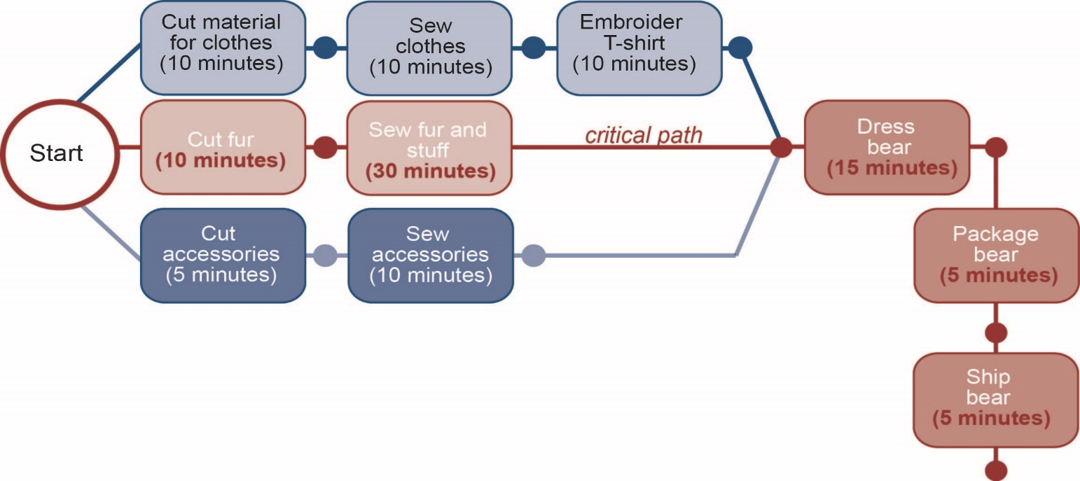
Planning Tools
PERT Chart
Vermont Teddy Bears
PERT Chart
Figure CC BY 4.0. Retrieved from: https://commons.wikimedia.org/wiki/Category:Figures_from_Fundamentals_of_Business_by_Skripak
Notes:
Think of a PERT chart like a roadmap for a project. The key element is the critical path. The critical path is the set of tasks, which if one is delayed will delay the project. Managers need to identify the critical path and watch it like a hawk.

Slide 16
Production Technology
Computer-aided design (CAD)
  E.g. homes, airplanes
Computer-aided manufacture (CAM)
  Robotics
CAD/CAM
  3-D Printers
Computer-integrated manufacture (CIM)
  Incorporates order entry, inventory, shipping

Slide 17
Service Operations Management
Services
Are intangible
Often customized
Have high customer contact
Notes:
Services are things like doing taxes, car repair, landscaping, etc.

Slide 18
Operations Processes
Goods production
  Make-to-order
  Make-to-stock
Look for operational efficiency
  E.g. Burger King moved drink station out from behind counter

Slide 19
Operations Facilities
Site selection
  Near customers
Size and layout
  To be efficient
  To meet customer needs
Capacity planning
  Number of customers
  When customers need service
  Time to service a customer
  Other factors, e.g. weather

Slide 20
Operations Facilities
How would you forecast the demand for
  New heated driveways in Somerset County
  Fried food at a restaurant
  Number of bathrooms in a stadium
  Lawn mowing jobs in Hunterdon County
  Kindergarten classrooms in Bridgewater
  Piano tuners in Manville

Slide 21
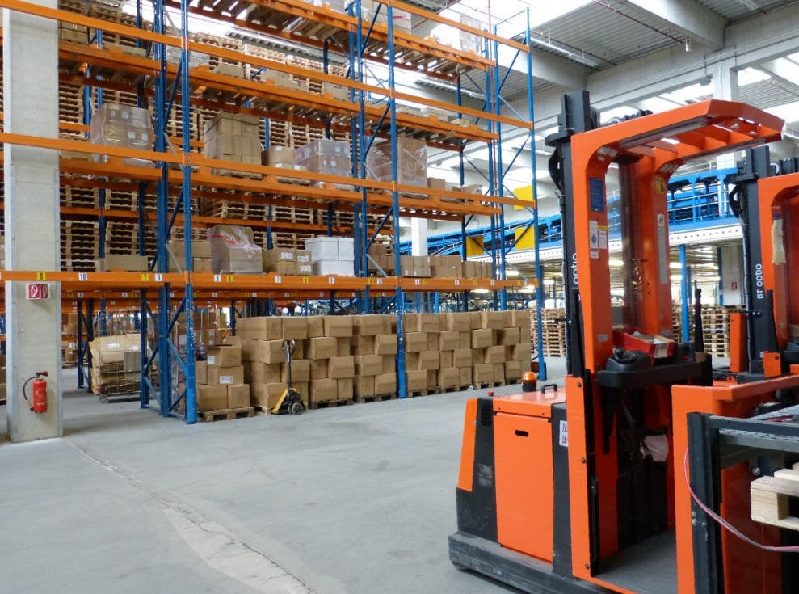
Managing Operations
Scheduling
  Who works when
Inventory control
  Similar to
  production
  management

Slide 22
Managing Quality
Total quality management (TQM)
Customer Satisfaction
  Meet customer needs at every stage
  Get feedback and track
Employee involvement
  Need commitment at every level
  Provide training
  May work in quality circles
Continuous process improvement
Notes:
Continuous process improvement means that a business is always on the lookout for ways to improve. That may sound like a no-brainer but many companies fail to do that. The best companies make it a part of the culture.

Slide 23
Managing Quality
Statistical Process Control
Measure quality
Meet quality objectives
Six-Sigma process
  99.99966% free from defects
  3.4 defects per million

Slide 24
Managing Quality
Statistical Process Control
What is an acceptable number of defects for
  Nails
  Lawn mowing
  Surgical stents for opening arteries
  Garbage pickup
  T-shirts

Slide 25
Managing Quality
Outsourcing
Note: not necessarily out of the country
Manufacturing
  E.g. Apple uses Foxconn for manufacturing
Services
  E.g. RVCC uses Culinart for cafeteria
Notes:
Outsourcing simply means taking a function within a business and hiring another business to do it. We often think of outsourcing as sending work out of the country but it doesn’t need to be that.

