Slide 1
Personal Finances
©William Klinger. This work is licensed under a Creative Commons Attribution 4.0 license
Adapted from Fundamentals of Business
Download this book for free at: https://vtechworks.lib.vt.edu/handle/10919/84848

Slide 2
Review
What are managerial accounting and financial accounting?
Describe an income statement.
Describe a balance sheet.
Calculate a break-even point.
How do you calculate and what do these ratios tell you?
ROS, EPS, current ratio, debt-to-equity

Slide 3
Learning Objectives
Develop strategies for debt.
Explain how to manage income and expenses.
Explain the financial planning life cycle.
Discuss the advantages of a college education in meeting short- and long-term financial goals.
Explain compound interest and the time value of money.
Discuss the value of getting an early start on your plans for saving.
Adapted from Fundamentals of Business
Download this book for free at: ttp://hdl.handle.net/10919/70961

Slide 4
Debt
Debt needs to repaid
Major source of financial ruin
Credit score
Attempt to measure a person’s ability to repay debt

Slide 5
Credit Rating
Determines the cost to borrow
Kept by credit bureaus
Equifax
Experian
TransUnion
FICO score
Ranges 300 – 850
Based on
Payment history
Total debt
Length of credit history
Amount of new credit
Types of credit

Slide 6
Credit Rating
Figure CC BY 4.0. Retrieved from: https://commons.wikimedia.org/wiki/Category:Figures_from_Fundamentals_of_Business_by_Skripak

Slide 7
Building Good Credit
Figure CC BY 4.0. Retrieved from: https://commons.wikimedia.org/wiki/Category:Figures_from_Fundamentals_of_Business_by_Skripak

Slide 8
Managing Debt
Credit cards
Pay off the balance each month
If you don’t have the money, don’t charge it
Borrowing
Do not borrow money for things that go down in value
What doesn’t go down in value?
Education
Home

Slide 9
Managing Monthly Expenses
Keep track of your weekly expenses
Take a set amount out of the bank and spend only that
Look for cheaper alternatives
Not gourmet coffee
Cut the cable
Buy items on sale
Eat out less

Slide 10
Managing Monthly Expenses
Keep track of your expenses
Create an income statement
Are you saving money?
Pay yourself first
First, set aside your savings
Live off the remainder

Slide 11
Financial Planning
Gather information
Income
Expenses
Assets
Debt
Create personal financial statements

Slide 12
Personal Financial Statements
Income statement
Start with your income
Detail expenses
Recurring
Discretionary
Your “net income” is your savings
savings rate = savings / income
Balance sheet
Record assets and liabilities
Your owners’ equity is your net worth
net worth = assets - liabilities

Slide 13
Financial Planning
How much will you need for future purchases?
Car
Home
Appliances
Think of retirement as financial freedom
How much income do you want to be free?
How much wealth will you need to be free?

Slide 14
Financial Life Cycle
Figure CC BY 4.0. Retrieved from: https://commons.wikimedia.org/wiki/Category:Figures_from_Fundamentals_of_Business_by_Skripak

Slide 15
Years to “Financial Freedom”
Savings Rate | Years to “Freedom” | Age when “Free”
5% | 50 | 72
10% | 40 | 62
15% | 34 | 56
20% | 30 | 52
25% | 26 | 48
Assumes:
- 7% annual rate of return.
- Start saving at age 22.
Source: http://www.forbes.com/sites/robertberger/2015/03/03/ how-much-of-your-income-should-you-save/2/?ss=retirement

Slide 16
Time is Money
Compound interest
Earning interest on your interest
Albert Einstein
“Compound interest is the most powerful force in the universe.”
“Compound interest is the eighth wonder of the world. He who understands it, earns it ... he who doesn't ... pays it.”

Slide 17
Time Value of Money
Money is worth more now than the identical sum in the future.
E.g. Cash value of lottery is less than sum of annual payments
If give up money now, want more money in the future
Interest
Investment return
The longer the time, the more you require

Slide 18
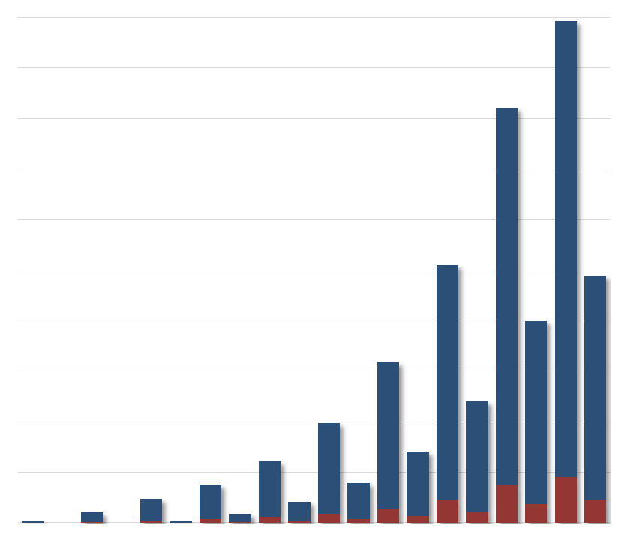
Value of Saving Early
$1,000,000
The 24 year old invested $2,000 per year for twelve years. She stopped adding money in, but her total still grew: by age 67, she had almost a million dollars!
$900,000
$800,000
$700,000
$600,000
Her friend did not invest until she was 35. Even though she invested $2000 every year, by the time she was 67, she still had not caught up with her wiser friend: she had less than $500,000.
$500,000
$400,000
$300,000
$200,000
$100,000
Age: 24 30 35 40 45 50 55 60 65 67
You cannot get back those missed years of compound interest.
Figure CC BY 4.0. Retrieved from: https://commons.wikimedia.org/wiki/Category:Figures_from_Fundamentals_of_Business_by_Skripak

Slide 19
Value of Saving Early
How to save a million dollars by age 67
Make your first payment at age: | And this is what you’ll have to save each month
20 | $33
21 | $37
22 | $42
23 | $47
24 | $53
25 | $60
26 | $67
27 | $76
28 | $85
30 | $109
35 | $199
40 | $366
50 | $1,319
60 | $6,253
Starting to save late is expensive.
Figure CC BY 4.0. Retrieved from: https://commons.wikimedia.org/wiki/Category:Figures_from_Fundamentals_of_Business_by_Skripak

Slide 20
What the Billionaires Drive
Warren Buffett - $45k Cadillac
Sergey Brin - $31k Prius
Mark Zuckerberg - $31k Acura
Jeff Bezos - $17k Accord
Steve Ballmer - $25k Ford Fusion
Jim Walton - $9k Dodge Dakota
Expensive cars are not a sign that someone has money but that they had money.
Source: cnbc.com

Slide 21
Other Financials
Insurance
Life – need changes over time
Always buy term insurance, never whole life
Medical
Auto
Home
Expenses
Never pay retail
Use store cards
Wait for sales
Negotiate
It’s like a tax-free raise

Slide 22
Twelve Financial Truths Jonathon Clements, WSJ 6/18/06
It’s hard to cut back
You will never be satisfied
Borrowings have to be repaid
Fancy cars and expensive clothes are not a sign of wealth
Your family could prove to be your greatest liability
Investors face three enemies
Inflation
Taxes
Investment costs

Slide 23
Twelve Financial Truths Jonathon Clements, WSJ 6/18/06
Adding investments can lower risk
Diversification is a mixed bag
Not all risk is rewarded
Most investors fail to beat the market
Change is costly
Your best investment strategy is saving

