Slide 1
Pricing Strategy
©William Klinger. This work is licensed under a Creative Commons Attribution 4.0 license
Adapted from Fundamentals of Business
Download this book for free at: https://vtechworks.lib.vt.edu/handle/10919/84848

Slide 2
Review
What is the marketing mix.
Explain marketing research.
Discuss various branding strategies.
Describe different types of promotion.
What is customer-relationship management?
Identify the advantages and disadvantages of social media marketing.

Slide 3
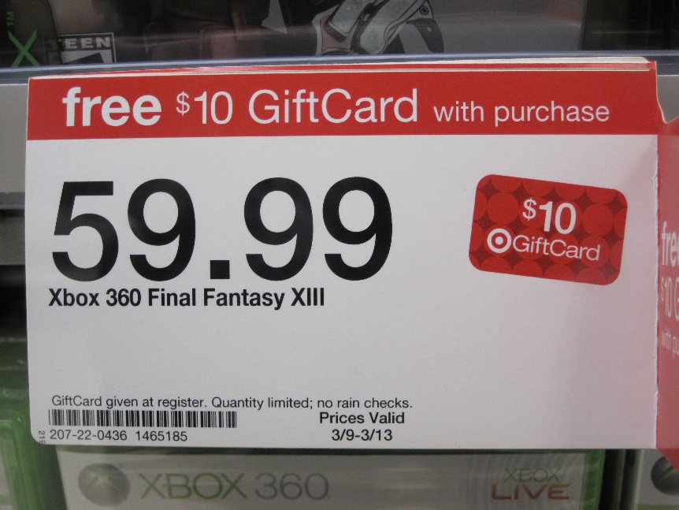
Learning Objectives
Identify pricing strategies that are appropriate for new and existing products
Understand the stages of the product life cycle.
Adapted from Fundamentals of Business
Download this book for free at: ttp://hdl.handle.net/10919/70961

Slide 4
Pricing Strategies
Skimming strategy
Get customers with highest willingness to pay
Penetration strategy
Build market share
Cost-based pricing
Good or bad?
Demand-based pricing
Use supply/demand
Notes:
Penetration strategy – typically low pricing.

Slide 5
Pricing Strategies
Dynamic pricing
Price varies with time and circumstances
E.g. airline flights
Prestige pricing
Give impression of high quality
“Price is a proxy for quality”
E.g. cosmetics

Slide 6
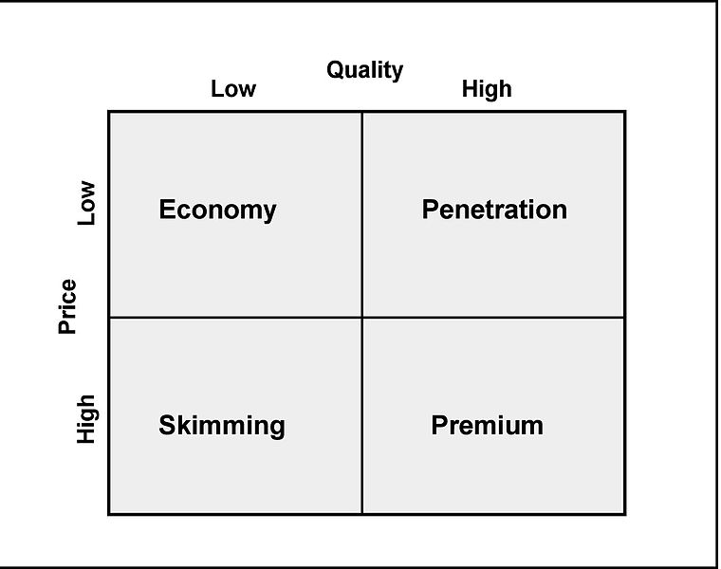
Pricing Strategies

Slide 7
Pricing Strategies
Odd-even pricing
Uses psychology
$9.99 viewed as cheaper than $10.00
Why do some stores price $9.98, $9.97, $9.96?
Loss leaders
Price one item low
Hope to entice customer to buy up or complementary product
Notes:
Stores might price a product with something like $9.98, not because there is a psychological advantage but because the last digit indicates something. For example .98 might mean the product is on sale and can be returned. .97 might mean the product cannot be returned. .96 might mean the product is damaged.

Slide 8
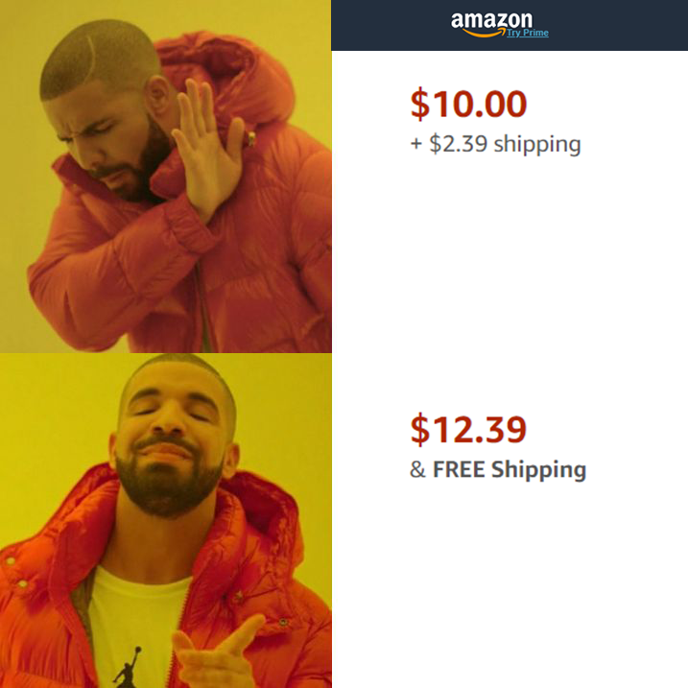
Pricing Strategies
Bundling
Combine two products or services
E.g. Cable TV, car packages

Slide 9
Pricing Strategies
Razor/Razor blade strategy
Special case of bundling strategy
Sell initial product cheaply or for free
Make profit from required add-ons
Examples?
Notes:
Think printers and ink.

Slide 10
Product Life Cycle
Stage: | Introduction | Growth | Maturity | Decline
Price Levels | Depends on choice of introductory strategy | Converges as competitors enter market | Initially high but tend to decline as growth disappears | Initially declines but may rise as competitors exit
Number of Competitors | Few | Rapidly Rising | Begins to decline through consolidation | Few or one
Industry Profits | Negative | Rising | Highest | Declining
Customers | Few – Innovators Only | Rising – Early Adopters | High/Stable, begins to drop late in cycle | Declining
Objectives | Awareness and Adoption | Gain Market Share | Defend Share and Maximize Profits | Milk Remaining Value, Minimize Investment
Figure CC BY 4.0. Retrieved from: https://commons.wikimedia.org/wiki/Category:Figures_from_Fundamentals_of_Business_by_Skripak

Slide 11
Product Life Cycle
What does a firm do to the product in each stage?
What is the distribution like in each stage?
Give examples of products in each stage.

