Slide 1
Structuring Organizations
©William Klinger. This work is licensed under a Creative Commons Attribution 4.0 license
Adapted from Fundamentals of Business
Download this book for free at: https://vtechworks.lib.vt.edu/handle/10919/84848

Slide 2
Review
Identify the four functions of management.
What goes into a strategic plan?
What are contingency plans?
What is SWOT analysis?
What are the different management styles?
What are characteristics of good business goals?
Understand benchmarking.
Describe the skills needed of a manager.

Slide 3
Learning Objectives
Identify levels of management.
Discuss various options for organizing.
Understand how specialization helps make organizations more efficient.
Know how an organization can departmentalize.
Understand key organizational terms.
Figure CC BY 4.0. Retrieved from: https://commons.wikimedia.org/wiki/Category:Figures_from_Fundamentals_of_Business_by_Skripak

Slide 4
Levels of Management
Executive (Top) management
CEO, CFO, President, VP, …
Strategic planning and execution
Middle management
Director, Regional Manager, …
Tactical planning and execution
First-level management
Supervisor, Manager, Foreperson
Operational planning and execution

Slide 5
Levels of Management
Figure CC BY 4.0. Retrieved from: https://commons.wikimedia.org/wiki/Category:Figures_from_Fundamentals_of_Business_by_Skripak

Slide 6
Organizational Structure
Types of Organizational Structures
Line Organization
Groups directly involved in the creation and sales of products and services
E.g. R&D, production, sales
Staff Organization
Groups that support the line organization functions
E.g. Finance, Human Resources
Notes:
Line Organizations
a. the oldest and simplest form, establishes a direct flow of authority from the chief executive to subordinates
b. has a clear chain of command – a set of relationships that indicates who gives direction to whom and who reports to whom
c. helps to prevent buck passing
d. disadvantage is that managers are held accountable even though they may lack expertise in that area and can also be easily overburdened with administrative details
e. most effective in small organizations

Slide 7
Individual Contributor Assignments
Job specialization
Pros
Cons
Alternate assignments
Responsibility
Authority
Notes:
There is a difference between responsibility and authority. With responsibility you are held accountable for an outcome. Authority means you have the permission to do something. What is awful is to be responsible but have no authority. For example, you might be responsible for sales in a particular area but you do not have the authority to assign sales staff to clients.

Slide 8
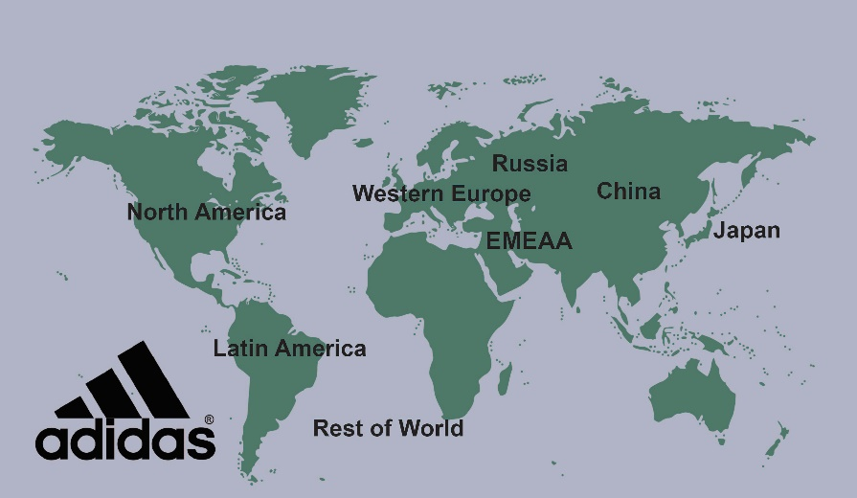
Organization Structures
Functional
Divisional
Product
Customer
Process
Geographic
Figure CC BY 4.0. Retrieved from: https://commons.wikimedia.org/wiki/Category:Figures_from_Fundamentals_of_Business_by_Skripak
Notes:
Functional organizations are centered around the types of work people do. For example, R&D, manufacturing, marketing, and sales. These organizations typically have the lowest costs because each functional area becomes very efficient and can their resources for the variety of things a business might sell.
A product organization groups the staff into different product groups. This is more responsive to customer needs than a functional organization but it is not as efficient because there is typically some duplication of work or resources. For example, you might need a welder in each product group but if you were functionally organized, you might need only one welder for all the products.
Customer organizations group staff by the type of customer being targeted. It and the other divisional structures have strengths and weaknesses analgous to the product structure.

Slide 9
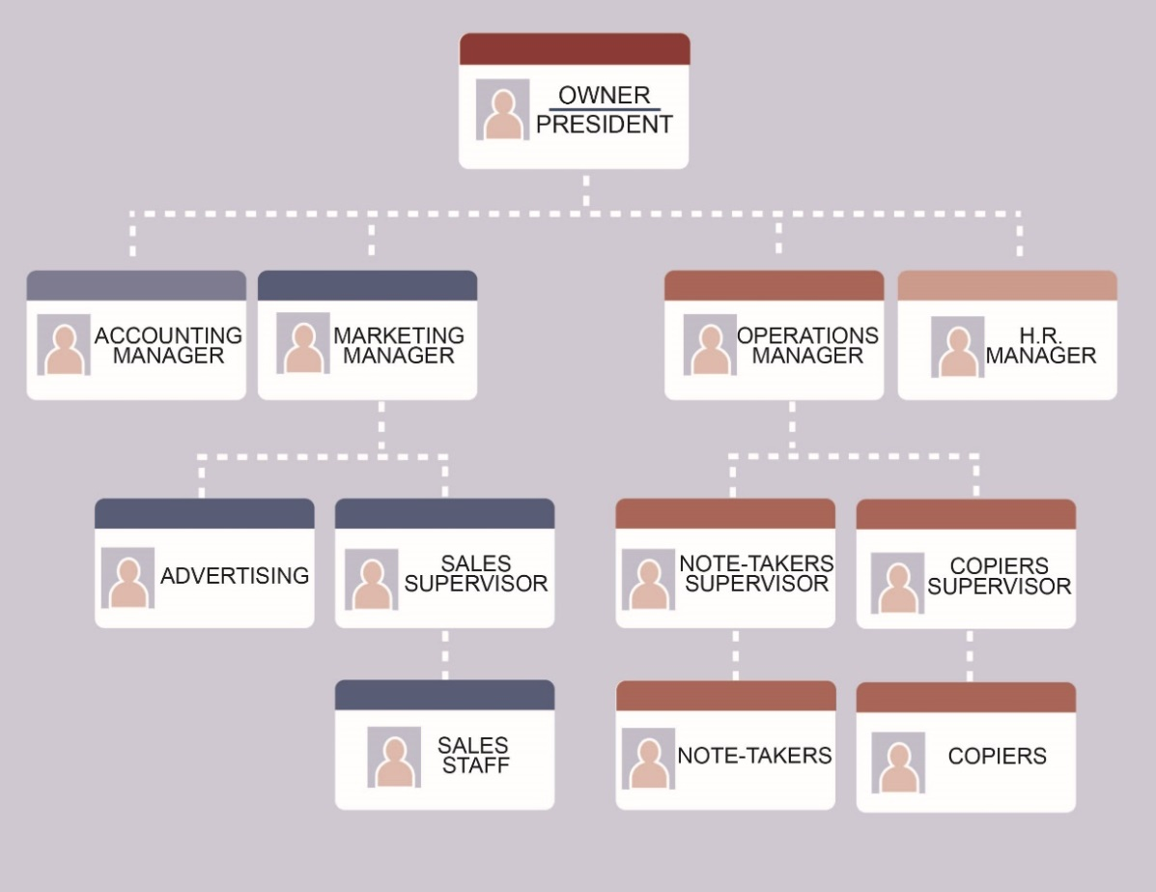
Functional Organization Chart
Figure CC BY 4.0. Retrieved from: https://commons.wikimedia.org/wiki/Category:Figures_from_Fundamentals_of_Business_by_Skripak

Slide 10
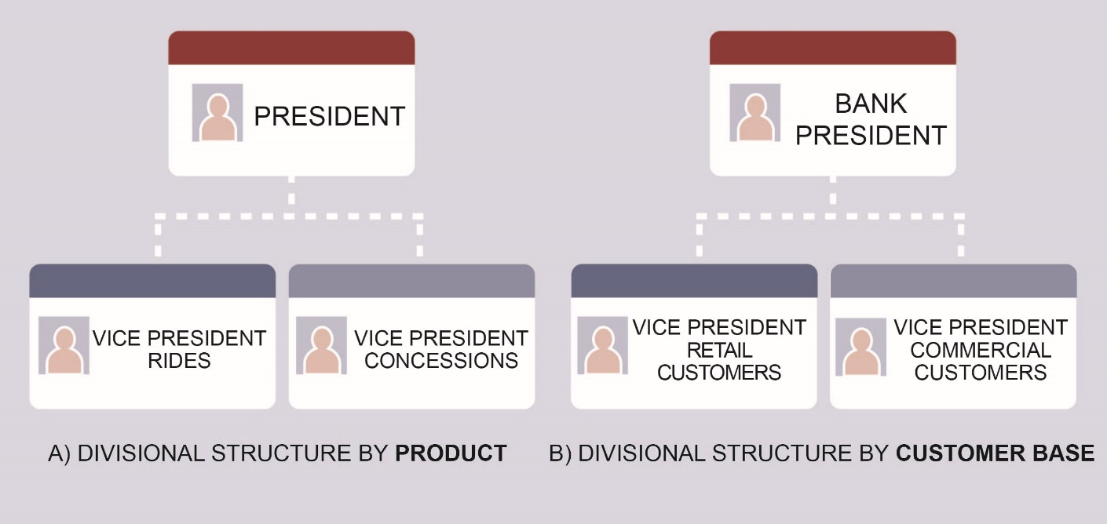
Divisional Organization Charts
Figure CC BY 4.0. Retrieved from: https://commons.wikimedia.org/wiki/Category:Figures_from_Fundamentals_of_Business_by_Skripak

Slide 11
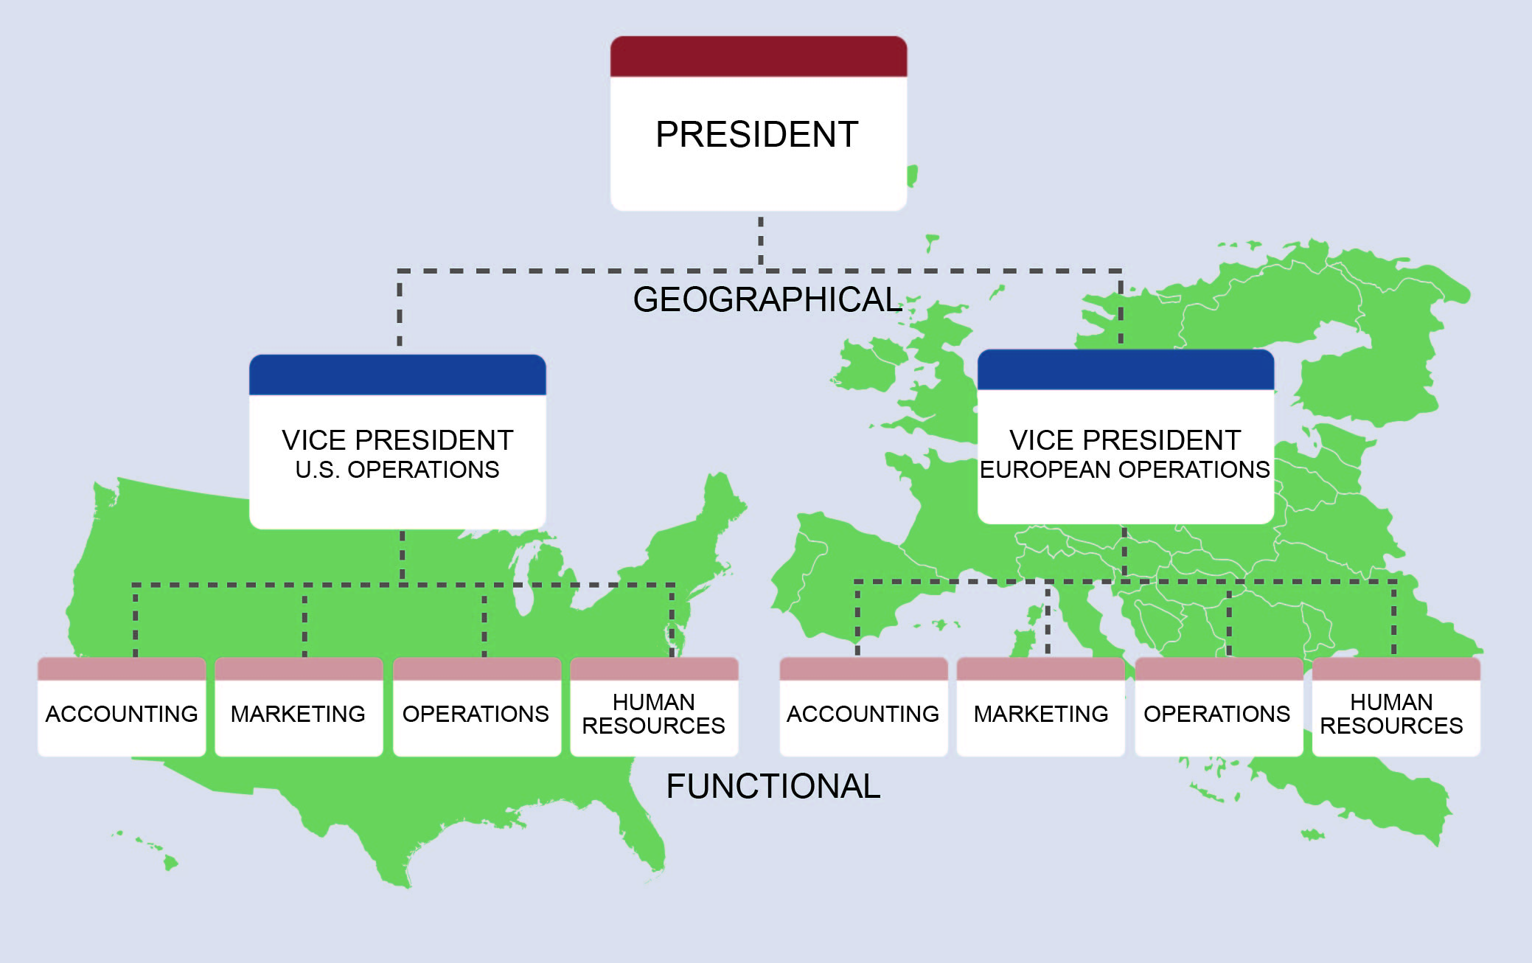
Combined Geographic and Functional Organization
Figure CC BY 4.0. Retrieved from: https://commons.wikimedia.org/wiki/Category:Figures_from_Fundamentals_of_Business_by_Skripak

Slide 12
Matrix Organization
Often used with geographic organizations.
Figure CC BY 4.0. Retrieved from: https://commons.wikimedia.org/wiki/Category:Figures_from_Fundamentals_of_Business_by_Skripak
Notes:
Matrix organizations try to combine two different structures into one. The problem with this is that the staff have multiple managers to whom they are accountable. Ever have two bosses?

Slide 13
Reporting Relationships
Chain of command
Unity of command
Which structure violates this?
Span of control
In what situations would you use:
Narrow span?
Wide span?
Delegation
Empowering staff
not simply assigning tasks
Notes:
Chain of command – just like in the military. Who reports to whom.
Unity of command – everyone has one and only one manager.
Span of control – the number of people who report to a manager.

Slide 14
Organization Characteristics
Structures
Tall
Flat
Decision making
Centralized
Decentralized
Notes:
Tall organizations have many levels of management. Flat ones have less. Both are relative. If you have a million employees, you will have more levels of management that a business with 200 people. Key to being a flat organization is increased span of control.
The fewer the levels of management, the faster the communication and the more responsive the business is.
Centralized decision making is used when you want to control the decisions being made. For example, not everyone should be able to change the company logo. Decentralized is used when you want fast decision making. You might allow some decentralized decision making in giving discounts, for example.

Slide 15
Exercises
What type of organization structure might you use for a firm that:
Only makes hot dogs (e.g. Ball Park)
Makes cars, boats, motorcycles (e.g. Honda)
Creates new technologies (e.g. Google)
Sells food world-wide (e.g. McDonalds)
What organizational characteristics might each have?

