Slide 1
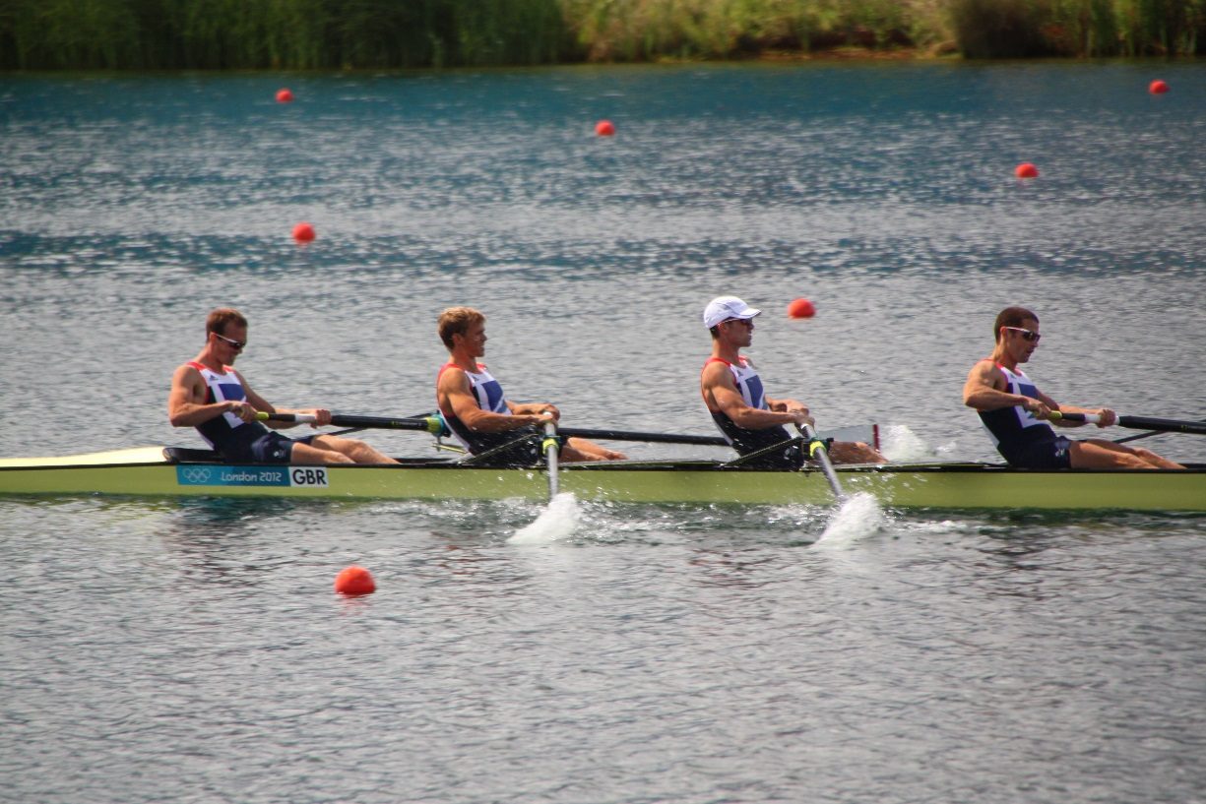
Teamwork in Business
©William Klinger. This work is licensed under a Creative Commons Attribution 4.0 license
Adapted from Fundamentals of Business
Download this book for free at: https://vtechworks.lib.vt.edu/handle/10919/84848

Slide 2
Learning Objectives
1. Define a team and describe its key characteristics.
2. Explain why organizations use teams and describe different types of teams.
3. Explain why teams may be effective or ineffective.
4. Identify factors that contribute to team cohesiveness.
Adapted from Fundamentals of Business
Download this book for free at: ttp://hdl.handle.net/10919/70961

Slide 3
Learning Objectives
5. Understand the importance of learning to participate in team-based activities.
6. Identify the skills needed by team members and the roles that members of a team might play.
7. Learn how to survive team projects in college.
8. Explain the skills and behaviors that foster effective team leadership
Adapted from Fundamentals of Business
Download this book for free at: ttp://hdl.handle.net/10919/70961

Slide 4
Team Characteristics
• Share accountability for achieving specific common goals
• Function interdependently
• Require stability
• Hold authority and decision-making power
• Operate in a social context
Adapted from Fundamentals of Business
Download this book for free at: ttp://hdl.handle.net/10919/70961

Slide 5
Types of Teams
Manager-led
Self-managing (self-directed)
Cross-functional
Virtual
Adapted from Fundamentals of Business
Download this book for free at: ttp://hdl.handle.net/10919/70961

Slide 6
Effective Teams
• Members depend on each other.
• Members trust one another.
• Members work better together than individually.
• Members become boosters.
• Team members enjoy being on the team.
• Leadership rotates.
Adapted from Fundamentals of Business
Download this book for free at: ttp://hdl.handle.net/10919/70961

Slide 7
Team Cohesiveness Factors
Size
Similarity
Success
Exclusiveness
Competition
Adapted from Fundamentals of Business
Download this book for free at: ttp://hdl.handle.net/10919/70961

Slide 8
Groupthink
Tendency to conform to group pressure in making decisions
Why a problem?
Adapted from Fundamentals of Business
Download this book for free at: ttp://hdl.handle.net/10919/70961

Slide 9
Team Obstacles
Unwillingness to cooperate
Lack of managerial support
Failure of managers to delegate authority
Adapted from Fundamentals of Business
Download this book for free at: ttp://hdl.handle.net/10919/70961

Slide 10
Required Team Skills
Technical
Decision-making
Problem-solving
Interpersonal
Adapted from Fundamentals of Business
Download this book for free at: ttp://hdl.handle.net/10919/70961

Slide 11
Team Roles
Task-facilitating
Focused on meeting team goals
Monitors progress
Enforces decisions
Relationship-building
Focused on group cohesiveness
Concerned about group chemistry
Blocking
Non-participant
“Social Loafer”
Adapted from Fundamentals of Business
Download this book for free at: ttp://hdl.handle.net/10919/70961

Slide 12
Leadership
Demonstrate integrity
Be clear and consistent
Generate positive energy
Acknowledge common point of view
Manage agreement and disagreement
Encourage and coach
Share information
Adapted from Fundamentals of Business
Download this book for free at: ttp://hdl.handle.net/10919/70961

Slide 13
Stages of Team Development
Forming
Storming
Norming
Performing

