Slide 1

Accounting and Financial Information
Chapter 16
Download this book for free at: ttp://hdl.handle.net/10919/70961

Slide 2
Review
What are the different pricing strategies?
Give an example of products and their pricing strategy.
Describe the product life cycle.
What is the marketing mix like in each stage of the product life cycle?

Slide 3
Learning Objectives
Know the differences between managerial accounting and financial accounting.
Identify users of accounting information.
Explain the income statement.
Explain the balance sheet.
Calculate a break-even point.
Evaluate a company’s performance using financial statements and ratio analysis.
Download this book for free at: ttp://hdl.handle.net/10919/70961

Slide 4
Accounting
Why do accounting?
Who needs the information?

Slide 5
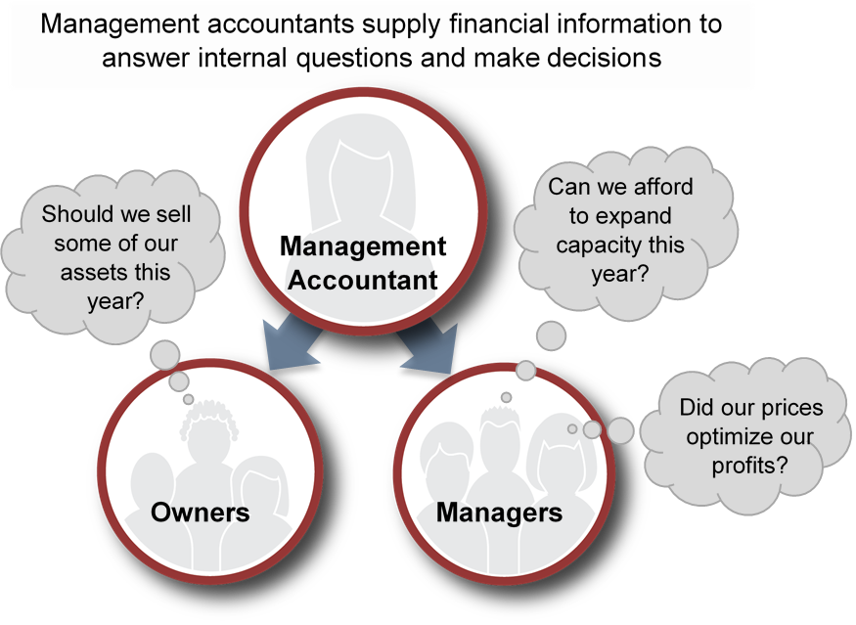
Managerial Accounting
Download this book for free at: ttp://hdl.handle.net/10919/70961

Slide 6
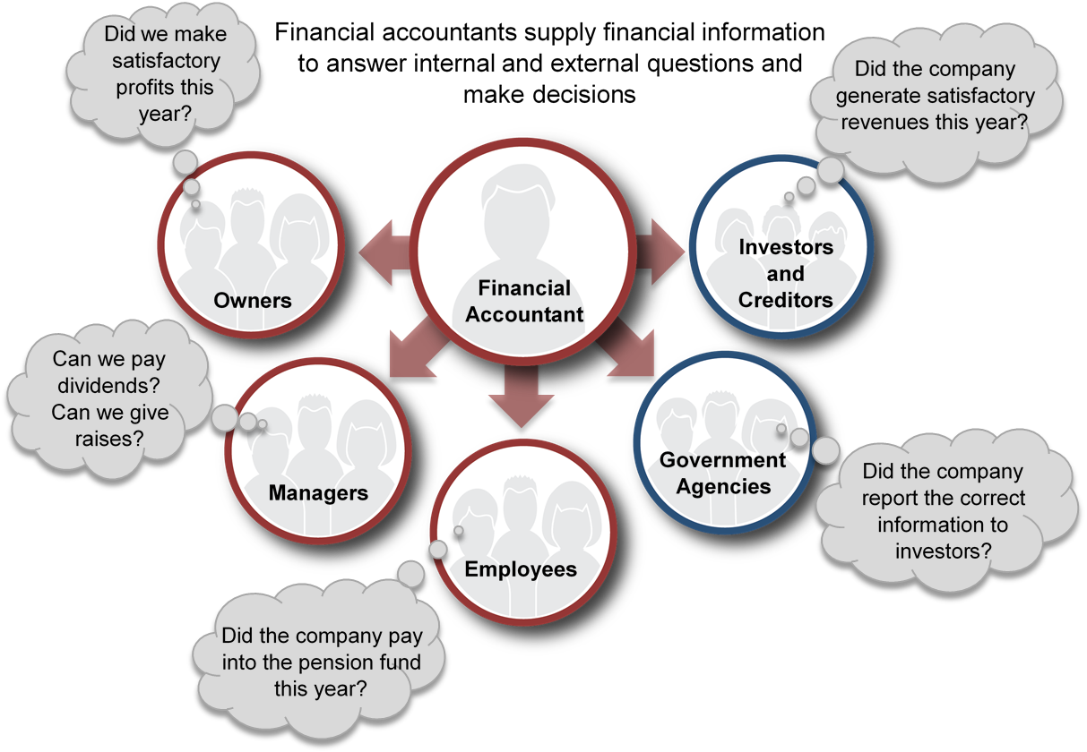
Financial Accounting
Download this book for free at: ttp://hdl.handle.net/10919/70961

Slide 7
Financial Accounting
Uniform set of rules
  In U.S.
    GAAP, generally accepted accounting principles
    Created by FASB
  Internationally
    IFRS, international financial reporting standards
    Created by IASB

Slide 8
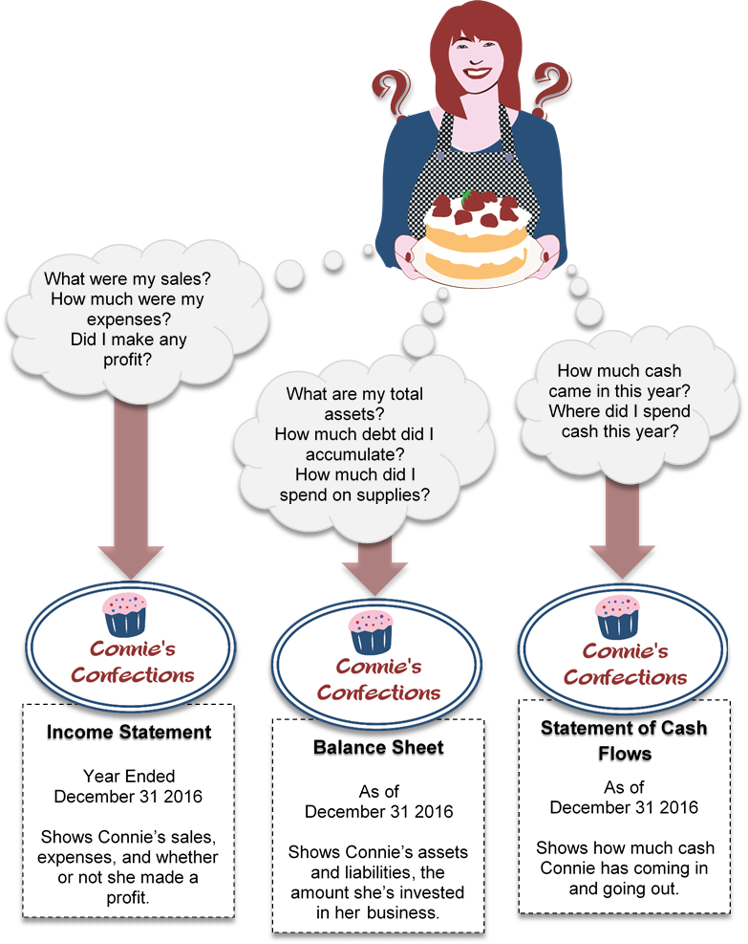
Basic Financial Accounting Statements
Download this book for free at: ttp://hdl.handle.net/10919/70961

Slide 9
Income Statement
Did the firm make a profit?
Over a period of time
Over a monthly, quarter, or fiscal year

Slide 10
Income Statement
Stress-Buster Income Statement Month Ended September 30, 2016
Sales (100x$10.00) |  | $1,000
Less cost of goods sold (100x$6) |  | 600
Gross profit (100x ($10 -$6)) |  | 400
Less operating expenses
Salaries | 240
Advertising | 40
Table rental | 20
 | 300
Operating income ($400-$300) |  | 100
Taxes |  | 25
Net income (profit) |  | $75
Revenues
COGS
Gross margin (%)
Operating expenses
Earnings
Download this book for free at: ttp://hdl.handle.net/10919/70961

Slide 11
Balance Sheet
Shows value of firm on the books
  On a given date
  Monthly, quarterly, or fiscal year
Assets – what a firm owns
Liabilities – what a firm owes
Owners’ Equity – owners’ investment
Fundamental accounting equation
    Assets = Liabilities + Owners’ Equity
    or
    Owners’ Equity = Assets - Liabilities

Slide 12
Balance Sheet
Give examples of:
Assets
Liabilities

Slide 13
Balance Sheet
Stress-Buster Company Balance Sheet As of September 1, 2016
Assets
Cash | $600
Liabilities and Owner’s Equity
Liabilities | 400
Owner’s Equity | 200
Total Liabilities and Owner’s Equity | $600
Assets – What a company owns
Liabilities – What a company owes
Owners’ Equity – Owners’ investment, value of the company – on the books.
Download this book for free at: ttp://hdl.handle.net/10919/70961

Slide 14
Breakeven Analysis
Answers the question:
How much do I have to sell to break even?
Fixed costs
  Do not change with number sold
  E.g. rent, advertising, insurance
Variable costs
  Depend upon number sold
  E.g. material costs, shipping
Contribution margin
  Gross profit on each sale

Slide 15
Breakeven Analysis
Calculate fixed costs
Calculate variable cost per unit
Calculate contribution margin
  = sales revenue – variable costs
  = (# sold x price) – (# sold x variable cost)
Calculate breakeven units
  = fixed costs / contribution margin

Slide 16
Break Even Analysis
Sales
Profit
Total Costs
$
Loss
Break Even Point
Units

Slide 17
Breakeven Analysis
Example
  You run a business making and selling toys and want to know how many you need to sell in order to break even. You pay workers $240 regardless of how much they make. You plan to spend $40 on advertising and need a $20 table to put the product together. The toys cost $5 each and are put in a box costing $1. How many units do you need to sell to break even?
Download this book for free at: ttp://hdl.handle.net/10919/70961

Slide 18
Breakeven Analysis
Example Solution
Determine your total fixed costs:
    Fixed costs = $240 salaries + $40 advertising + $20 table = $300
Identify your variable costs on a per-unit basis:
    Variable cost per unit = $6 ($1 for the box and $5 for toys)
Determine your contribution margin per unit: selling price per unit – variable cost per unit:
    Contribution margin = $10 selling price – $6 variable cost per unit
    = $4
Calculate your breakeven point in units: fixed costs ÷ contribution margin per unit:
    Breakeven in units = $300 fixed costs ÷ $4 contribution margin per unit
    = 75 units
Download this book for free at: ttp://hdl.handle.net/10919/70961

Slide 19
Financial Statement Analysis
How does the firm compare to other firms?
  Does it cost more to make its products?
  Does it have too much debt?
Need to compare firms of different sizes
  Different revenues
  Different assets
Use ratio analysis to compare

Slide 20

Profitability Ratios
Return on sales, ROS
  Percent profit on each sale
  = Net income / sales
Return on equity, ROE
  Percent return on owners’ investment
    = Net income / owners’ equity
Earnings per share, EPS
  Profit owners make on each share of stock
    = Net income / # share of stock

Slide 21
Liquidity Ratios
What is the financial strength of firm?
Current ratio
  Ability of firm to pay current bills
  Current assets – assets turning into cash within a year, e.g. inventory
  Current liabilities – debts owed with a year, e.g. short-term loan
current ratio = current assets / current liabilities

Slide 22
Debt Ratios
How great is the financial risk?
Debt ratio
  How much of the firm is financed by borrowing?
    = Liabilities / Assets
Debt-to-equity ratio
  Ratio of debt financing to equity financing
    = Liabilities / Owners’ equity

Slide 23
Efficiency and Effectiveness Ratios
Inventory turnover ratio
  How many times in a period does the firm replace its inventory?
  = COGS / Inventory
Examples
  Grocery store may turn over dairy inventory every two weeks
  Car dealer may turn over inventory every two months

